Slide 1
Car Parking Sensor

Slide 2
Objectives:
Parking sensors are proximity sensors for road vehicles designed to alert the driver of obstacles while parking.
These systems use either electromagnetic or ultrasonic sensors.

Slide 3
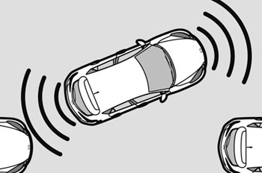
Introduction:
These systems feature to measure the distances to nearby objects via sensors located in the front and rear bumper fascias or visually minimized within adjacent grills or recesses.

Slide 4
Components
In this car parking sensor device project we
using components like :
Arduino Uno rev3 microcontroller
Ultrasonic sensor
Led’s
Buzzer
Resistors (optional)

Slide 5
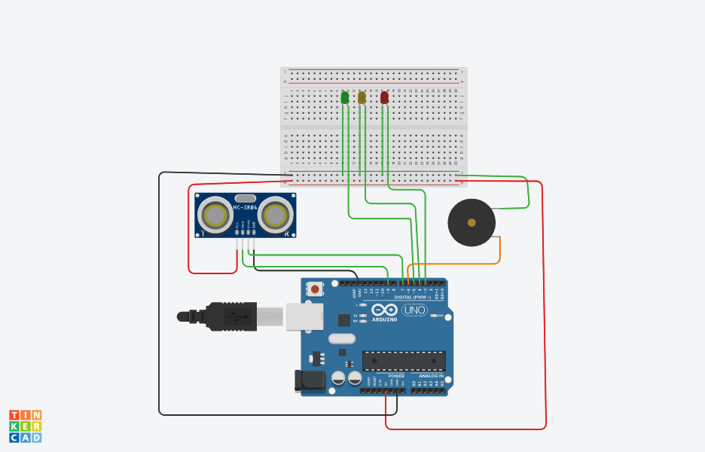
Circuit diagram:
Power supply

Slide 6
Explanation:
Ultrasonic sensors have two main components the transmitter (which emits the sound using piezoelectric crystals) and the receiver (which encounters the sound after it has travelled to and from the target
Ultrasonic sensors emit short, high-frequency sound pulses at regular intervals. If they strike an object, then they are reflected back as echo signals to the sensor, which itself computes the distance to the target based on the time-span between emitting the signal and receiving the echo.

Slide 7
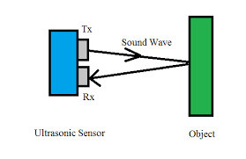
Range 2-400cm
Angle=10-15 degree
Sensor send high signal to micro controller, based on condition in program arduino provides output like led blink and buzzer sound
Formula to calculate the distance
distance = time * 0.0343 / 2

Slide 8
In this project, provided with three different conditions
if distance less than 50
output can observe as green led ON
if distance less than 30
output can observe as only yellow led ON
If distance less than 10
output can observe as only red led ON
with buzzer sound

Slide 9
Out comes:
For old model cars we can make the device
Cost effective
Ultrasonic sensor cover 10-15 degree of angle
so that it may not detect other area

